Slide 1
What is HTML
HTML is an acronym which stands for Hyper Text Markup Language which is used for creating web pages and web applications.

Slide 2
History of HTML
Tim Berners-Lee is known as the father of HTML. The first available description of HTML was a document called "HTML Tags" proposed by Tim in late 1991. The latest version of HTML is HTML5.

Slide 3
Features of HTML
It is a very easy and simple language. It can be easily understood and modified.
It is very easy to make an effective presentation with HTML because it has a lot of formatting tags.
It is a markup language, so it provides a flexible way to design web pages along with the text.
It facilitates programmers to add a link on the web pages (by html anchor tag), so it enhances the interest of browsing of the user.
It is platform-independent because it can be displayed on any platform like Windows, Linux, and Macintosh, etc.
It facilitates the programmer to add Graphics, Videos, and Sound to the web pages which makes it more attractive and interactive.
HTML is a case-insensitive language, which means we can use tags either in lower-case or upper-case.

Slide 4
HTML Text Editors
An HTML file is a text file, so to create an HTML file we can use any text editors.
Text editors are the programs which allow editing in a written text, hence to create a web page we need to write our code in some text editor.
There are various types of text editors available which you can directly download, but for a beginner, the best text editor is Notepad (Windows) or TextEdit (Mac).
After learning the basics, you can easily use other professional text editors which are, Notepad++, Sublime Text, Vim, etc.

Slide 5
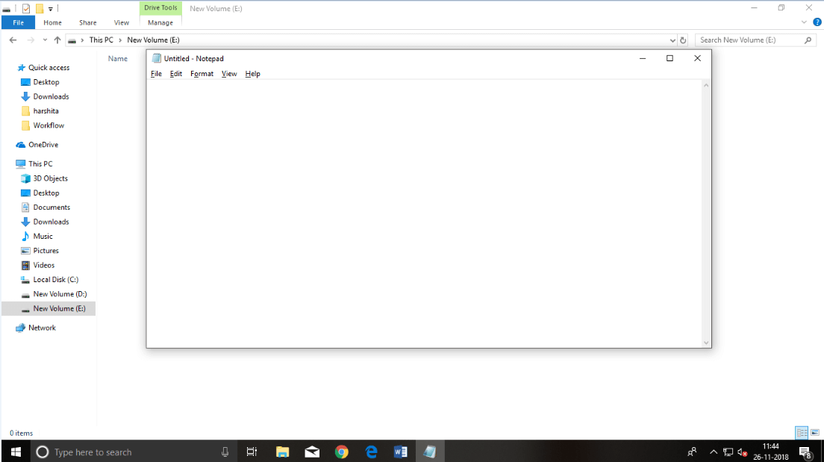
A. HTML code with Notepad. Notepad is a simple text editor and suitable for beginners to learn HTML. It is available in all versions of Windows, from where you easily access it. Step 1: Open Notepad (Windows)

Slide 6
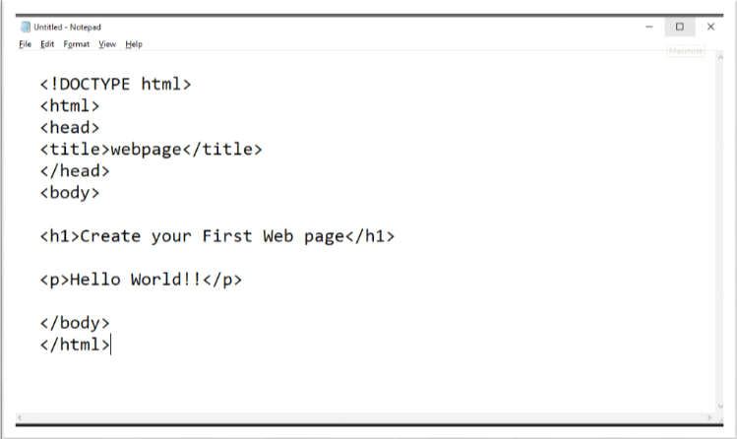
Step 2: Write code in HTML

Slide 7
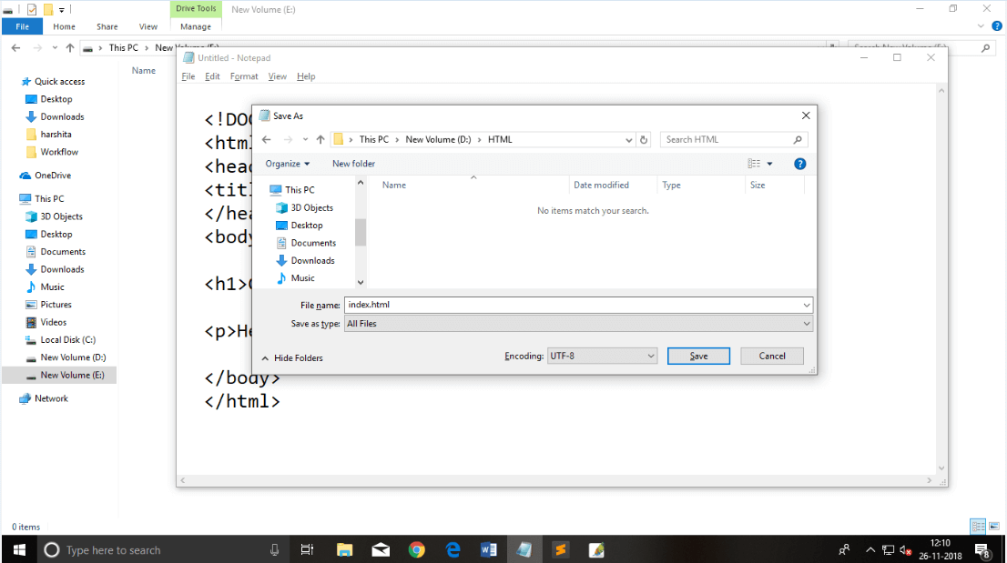
Step 3: Save the HTML file with .htm or .html extension.

Slide 8
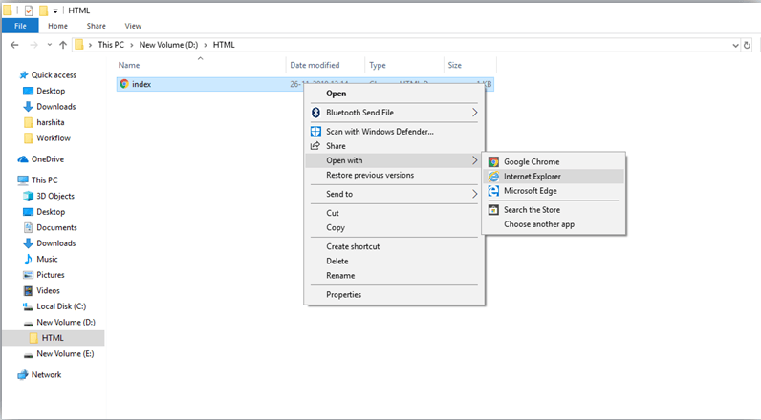
Step 4: Open the HTML page in your web browser. To run the HTML page, you need to open the file location, where you have saved the file and then either double-click on file or click on open with option

Slide 9
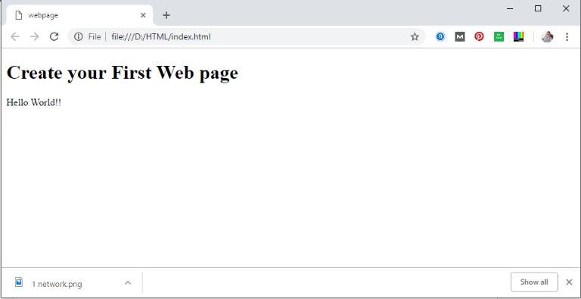
Result Page

Slide 10
Building blocks of HTML
An HTML document consist of its basic building blocks which are:
Tags: An HTML tag surrounds the content and apply meaning to it. It is written between < and > brackets.
Attribute: An attribute in HTML provides extra information about the element, and it is applied within the start tag. An HTML attribute contains two fields: name & value.

Slide 11
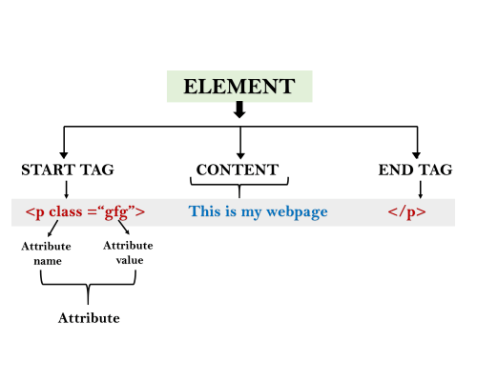
Syntax
<tag name attribute_name= " attr_value"> content </ tag name>
Elements: An HTML element is an individual component of an HTML file. In an HTML file, everything written within tags are termed as HTML elements.

Slide 12
HTML Tags
HTML tags are like keywords which defines that how web browser will format and display the content. With the help of tags, a web browser can distinguish between an HTML content and a simple content. HTML tags contain three main parts: opening tag, content and closing tag. But some HTML tags are unclosed tags.
When a web browser reads an HTML document, browser reads it from top to bottom and left to right. HTML tags are used to create HTML documents and render their properties. Each HTML tags have different properties.
An HTML file must have some essential tags so that web browser can differentiate between a simple text and HTML text. You can use as many tags you want as per your code requirement.
All HTML tags must enclosed within < > these brackets.
Every tag in HTML perform different tasks.
If you have used an open tag <tag>, then you must use a close tag </tag> (except some tags)

Slide 13
Syntax
<tag> content </tag
Note: HTML Tags are always written in lowercase letters. The basic HTML tags are given below:
<!-- --> | This tag is used to apply comment in an HTML document.
<!DOCTYPE> | This tag is used to specify the version of HTML
<a> | It is termed as anchor tag and it creates a hyperlink or link.
<aside> | It defines content aside from main content. Mainly represented as sidebar.
<audio> | It is used to embed sound content in HTML document.

Slide 14
<b> | It is used to make a text bold.
<big> | This tag is used to make font size one level larger than its surrounding content. (Not supported in HTML5)
<body> | It is used to define the body section of an HTML document.
<br> | It is used to apply single line break.
<button> | It is used to represent a clickable button
<canvas> | It is used to provide a graphics space within a web document.
<caption> | It is used to define a caption for a table.
<center> | It is used to align the content in center. (Not supported in HTML5)
<col> | It defines a column within a table which represent common properties of columns and used with the <colgroup> element.
<colgroup> | It is used to define group of columns in a table.

Slide 15
<dd> | It is used to provide definition/description of a term in description list.
<del> | It defines a text which has been deleted from the document.
<div> | It defines a division or section within HTML document.
<em> | It is used to emphasis the content applied within this element.
<embed> | It is used as embedded container for external file/application/media, etc.
<font> | It defines the font, size, color, and face for the content. (Not supported in HTML5)
<footer> | It defines the footer section of a webpage.
<form> | It is used to define an HTML form.
<frame> | It defines a particular area of webpage which can contain another HTML file. (Not supported in HTML5)
<frameset> | It defines group of Frames. (Not supported in HTML5)

Slide 16
<h1> to <h6> | It defines headings for an HTML document from level 1 to level 6.
<head> | It defines the head section of an HTML document.
<header> | It defines the header of a section or webpage.
<hr> | It is used to apply thematic break between paragraph-level elements.
<html> | It represents root of an HTML document.
<i> | It is used to represent a text in some different voice.
<iframe> | It defines an inline frame which can embed other content.
<img> | It is used to insert an image within an HTML document.
<input> | It defines an input field within an HTML form.
<ins> | It represent text that has been inserted within an HTML document.
<u> | It is used to render enclosed text with an underline.
<ul> | It defines unordered list of items.

Slide 17
<label> | It defines a text label for the input field of form.
<legend> | It defines a caption for content of <fieldset>
<li> | It is used to represent items in list.
<link> | It represents a relationship between current document and an external resource.
<mark> | It represents a highlighted text.
<marquee> | It is used to insert the scrolling text or an image either horizontally or vertically.
<nav> | It represents section of page to represent navigation links.
<ol> | It defines an ordered list of items.
<p> | It represents a paragraph in an HTML document.
<script> | It is used to declare the JavaScript within HTML document.
<small> | It is used to make text font one size smaller than documents base font size.

Slide 18
<span> | It is used for styling and grouping inline.
<strike> | It is used to render strike through the text. (Not supported in HTML5)
<strong> | It is used to define important text.
<style> | It is used to contain style information for an HTML document.
<sub> | It defines a text which displays as a subscript text.
<summary> | It defines summary which can be used with <details> tag.
<sup> | It defines a text which represent as superscript text.
<var> | It defines variable name used in mathematical or programming context.
<video> | It is used to embed a video content with an HTML document

Slide 19
<table> | It is used to present data in tabular form or to create a table within HTML document.
<tbody> | It represents the body content of an HTML table and used along with <thead> and <tfoot>.
<td> | It is used to define cells of an HTML table which contains table data
<template> | It is used to contain the client side content which will not display at time of page load and may render later using JavaScript.
<textarea> | It is used to define multiple line input, such as comment, feedback, and review, etc.
<tfoot> | It defines the footer content of an HTML table.
<th> | It defines the head cell of an HTML table.
<time> | It is used to define data/time within an HTML document.
<title> | It defines the title or name of an HTML document.
<tr> | It defines the row cells in an HTML table

Slide 20
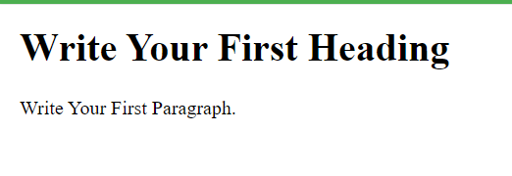
<!DOCTYPE>
<html>
<head>
<title>Web page title</title>
</head>
<body>
<h1>Write Your First Heading</h1>
<p>Write Your First Paragraph.</p>
</body>
</html>

Slide 21
Description of HTML Example
<!DOCTYPE>: It defines the document type or it instruct the browser about the version of HTML.
<html > :This tag informs the browser that it is an HTML document. Text between html tag describes the web document. It is a container for all other elements of HTML except <!DOCTYPE>
<head>: It should be the first element inside the <html> element, which contains the metadata(information about the document). It must be closed before the body tag opens.
<title>: As its name suggested, it is used to add title of that HTML page which appears at the top of the browser window. It must be placed inside the head tag and should close immediately. (Optional)
<body> : Text between body tag describes the body content of the page that is visible to the end user. This tag contains the main content of the HTML document.
<h1> : Text between <h1> tag describes the first level heading of the webpage.

Slide 22
All the content written between body elements are visible on web page.
Void element: All the elements in HTML do not require to have start tag and end tag, some elements does not have content and end tag such elements are known as Void elements or empty elements. These elements are also called as unpaired tag.
Some Void elements are <br> (represents a line break) , <hr>(represents a horizontal line), etc.
Nested HTML Elements: HTML can be nested, which means an element can contain another element.

Slide 23
HTML Formatting
HTML Formatting is a process of formatting text for better look and feel. HTML provides us ability to format text without using CSS. There are many formatting tags in HTML. These tags are used to make text bold, italicized, or underlined.

Slide 24
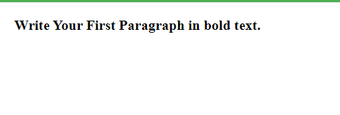
Bold Text
<!DOCTYPE>
<html>
<body>
<p> <b>Write Your First Paragraph in bold text.</b></p>
</body>
</html>

Slide 25
Italic Text
<!DOCTYPE>
<html>
<body>
<p> <i>Write Your First Paragraph in italic text.</i></p>
</body>
</html>
Write Your First Paragraph in italic text.

Slide 26
HTML Marked formatting
<!DOCTYPE>
<html>
<body>
<h2> I want to put a <mark> Mark</mark> on your face</h2>
</body>
</html>
I want to put a Mark on your face

Slide 27
Underlined and strike Text
<!DOCTYPE>
<html>
<body>
<p><u> <strike>Write Your First Paragraph with strikethrough</strike>.</u></p>
</body>
</html>
Write Your First Paragraph with strikethrough.

Slide 28
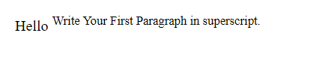
Superscript Text
<!DOCTYPE>
<html>
<body>
<p>Hello <sup>Write Your First Paragraph in superscript.</sup></p>
</body>
</html>

Slide 29
HTML Heading
A HTML heading or HTML h tag can be defined as a title or a subtitle which you want to display on the webpage. When you place the text within the heading tags <h1>.........</h1>, it is displayed on the browser in the bold format and size of the text depends on the number of heading.
There are six different HTML headings which are defined with the <h1> to <h6> tags, from highest level h1 (main heading) to the least level h6 (least important heading).
h1 is the largest heading tag and h6 is the smallest one. So h1 is used for most important heading and h6 is used for least important.

Slide 30
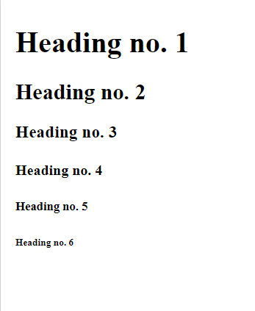
<!DOCTYPE html>
<html>
<body>
<h1>Heading no. 1</h1>
<h2>Heading no. 2</h2>
<h3>Heading no. 3</h3>
<h4>Heading no. 4</h4>
<h5>Heading no. 5</h5>
<h6>Heading no. 6</h6>
</body>
</html>

Slide 31
Marquee HTML
The Marquee HTML tag is a non-standard HTML element which is used to scroll a image or text horizontally or vertically.
In simple words, you can say that it scrolls the image or text up, down, left or right automatically.
Marquee tag was first introduced in early versions of Microsoft's Internet Explorer.

Slide 32
<!DOCTYPE html>
<html>
<body>
<marquee>This is an example of html marquee </marquee>
</body>
</html>

Slide 33
<marquee width="60%" direction="up" height="100px"> This is a sample scrolling text that has scrolls in the upper direction. </marquee>

